Slide 1
Discussion today: Photonic circuit simulation
Today we will introduce Lumerical INTERCONNECT, a systems level photonic circuit simulator (think SPICE for photonics).
Simple introductory example: Fabry-Perot resonator simulation in INTERCONNECT
More complicated example: Extract S-parameters from FDTD simulation and import into INTERCONNECT

Slide 2
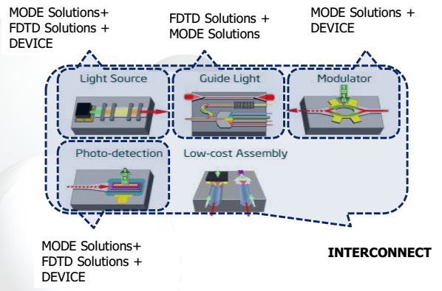

Slide 3
Fabry-Perot etalon example
a₁
Cavity
b₂
b₁
a₂ = 0
Mirror 1
Mirror 2
Question: What is the power transmission through Fabry-Perot etalon?
$$T={\left|\frac{b_{2}}{a_{1}}\right|}^{2}$$

Slide 4
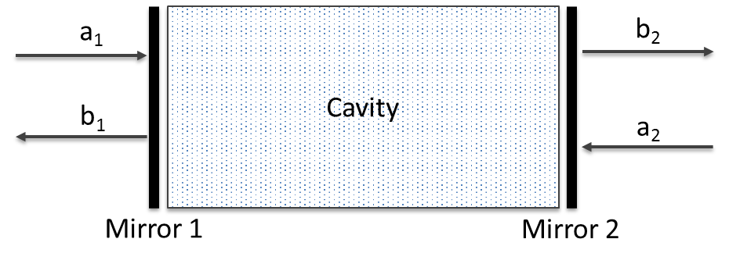
S-parameter
$$\left|\begin{matrix}S_{11} & S_{12} \\ S_{21} & S_{22}\end{matrix}\right|$$
Optical component
Two-port representation
We can generalize the Fabry-Perot cavity (and other optical components) to
a two-port representation which is fully defined by a scattering matrix (S-parameters).
This is completely analogous to electrical circuits.
$$S_{11}={\left.\frac{b_{1}}{a_{1}}\right|}_{a_{2}=0}$$
$$S_{12}={\left.\frac{b_{1}}{a_{2}}\right|}_{a_{1}=0}$$
$$S_{22}={\left.\frac{b_{2}}{a_{2}}\right|}_{a_{1}=0}$$
$$S_{21}={\left.\frac{b_{2}}{a_{1}}\right|}_{a_{2}=0}$$

Slide 5
Fabry-Perot etalon example
r₁
r₂
a₁
b’₁
a’₂
b₂
b₁
a’₁
b’₂
a₂ = 0
Mirror 1
Mirror 2
L
Question: What is the power transmission through Fabry-Perot etalon?
$$T={\left|\frac{b_{2}}{a_{1}}\right|}^{2}={\left|S_{21}\right|}^{2}$$

Slide 6
Fabry-Perot etalon example
r₁
r₂
a₁
b’₁
a’₂
b₂
b₁
a’₁
b’₂
a₂ = 0
Mirror 1
Mirror 2
L
(Recall $r=\frac{n_{1}−n_{2}}{n_{1}+n_{2}}$)
$$b_{1}={−r}_{1}a_{1}+t_{1}a_{1}^{′}$$
$$a_{1}^{′}=b_{2}^{′}e^{−jkL}$$
$$b_{1}^{′}=t_{1}a_{1}+r_{1}a_{1}^{′}$$
$$a_{2}^{′}=b_{1}^{′}e^{−jkL}$$
$$b_{2}={t_{2}a}_{2}^{′}$$
$${b′}_{2}={r_{2}a}_{2}^{′}$$

Slide 7
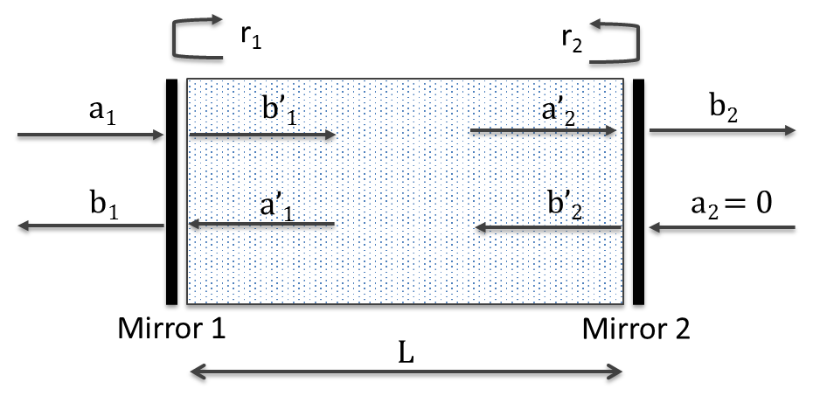
Fabry-Perot etalon example
$$b_{1}={−r}_{1}a_{1}+t_{1}a_{1}^{′}$$
$$b_{2}^{′}={r_{2}a}_{2}^{′}$$
$$b_{1}^{′}=t_{1}a_{1}+r_{1}a_{1}^{′}$$
$$a_{1}^{′}=b_{2}^{′}e^{−jkL}$$
$$b_{2}={t_{2}a}_{2}^{′}$$
$$a_{2}^{′}=b_{1}^{′}e^{−jkL}$$
$$S_{21}=\frac{b_{2}}{a_{1}}=\frac{t_{2}a_{2}^{′}}{a_{1}}$$
$$=\frac{t_{1}t_{2}a_{2}^{′}}{b_{1}^{′}−a_{1}^{′}r_{1}}$$
$$=\frac{t_{1}t_{2}b_{1}^{′}e^{−jkL}}{b_{1}^{′}−b_{1}^{′}{r_{1}r}_{2}e^{−2jkL}}$$
$$T={\left|S_{21}\right|}^{2}=\frac{{\left(1−R\right)}^{2}}{{\left(1−R\right)}^{2}+4R\sin^{2}{kL}}$$
$$=\frac{t_{1}t_{2}e^{−jkL}}{1−{r_{1}r}_{2}e^{−2jkL}}$$
$$for R=r_{1}^{2}=r_{2}^{2}$$

Slide 8
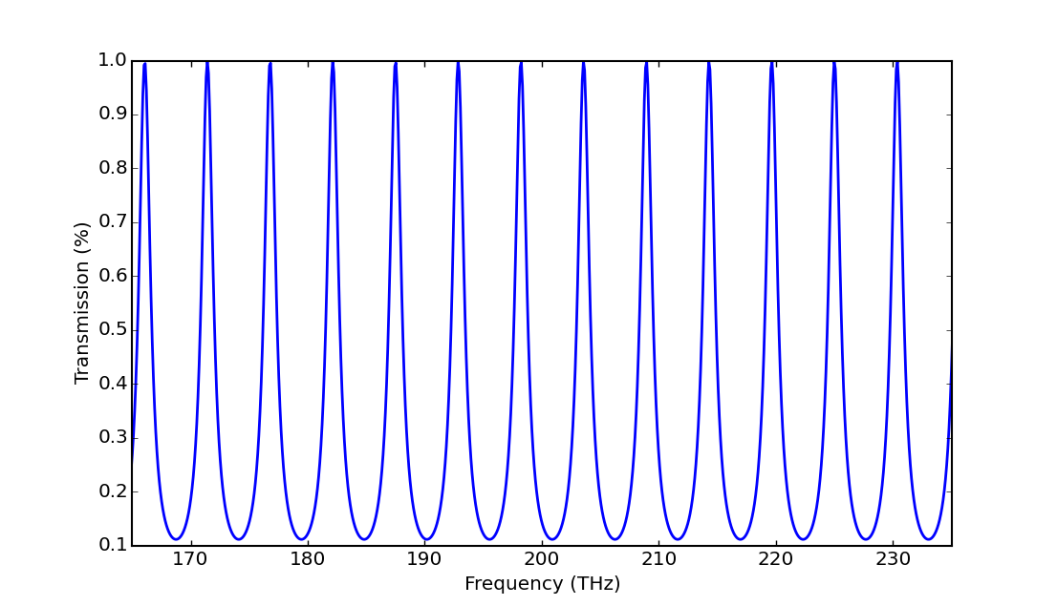
Fabry-Perot etalon example
$$T={\left|S_{21}\right|}^{2}=\frac{{\left(1−R\right)}^{2}}{{\left(1−R\right)}^{2}+4R\sin^{2}{kL}}$$
Free spectral range (FSR)
$$ν_{FSR}=\frac{c}{2nL}$$
R = 0.5
n = 2.8
L = 10µm
Transmission

Slide 9
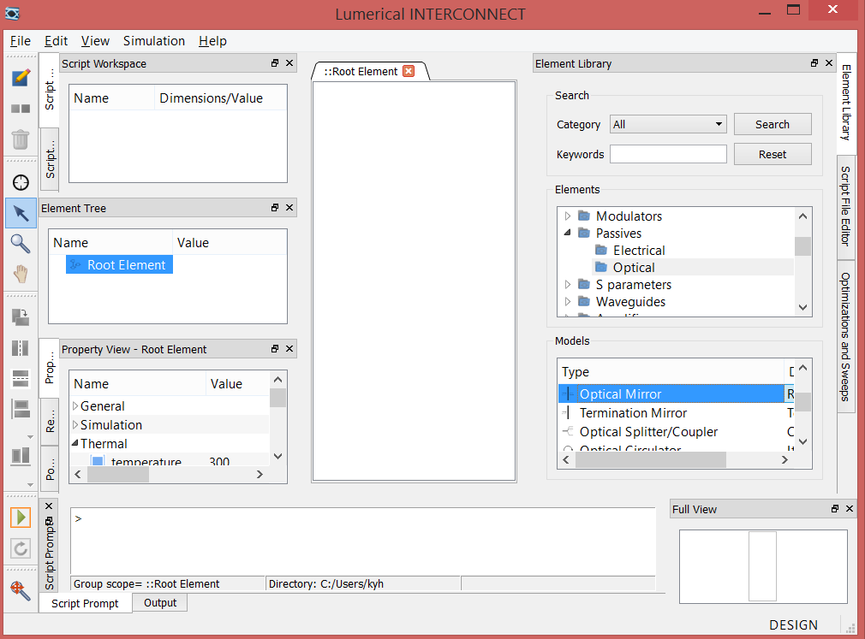
Fabry-Perot etalon simulation
Open INTERCONNECT
Add two Mirror and one Straight waveguide elements to the simulation space (click and drag)
Click and drag to center

Slide 10
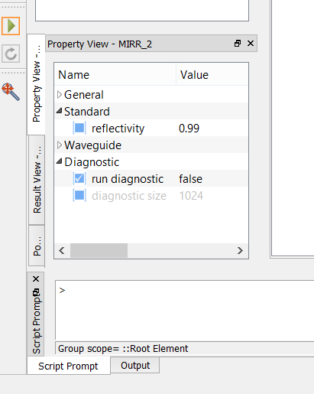
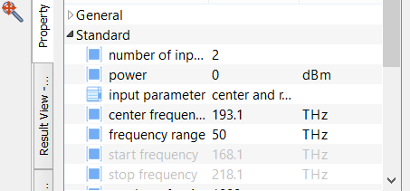
Fabry-Perot etalon simulation
Click on mirror element
Standard → Reflectivity = 0.5 for both mirrors
Click on waveguide element
Standard → Length = 10 μm (watch units!)
Waveguide → Mode 1 → effective index 1 = 2.8 group index 1 = 2.8
Add one Optical Network Analyzer to simulation space (Analyzers→Optical)
Change the following properties:
Standard → Number of input ports = 2 Frequency range = 50 THz (units!) Number of points = 1000

Slide 11
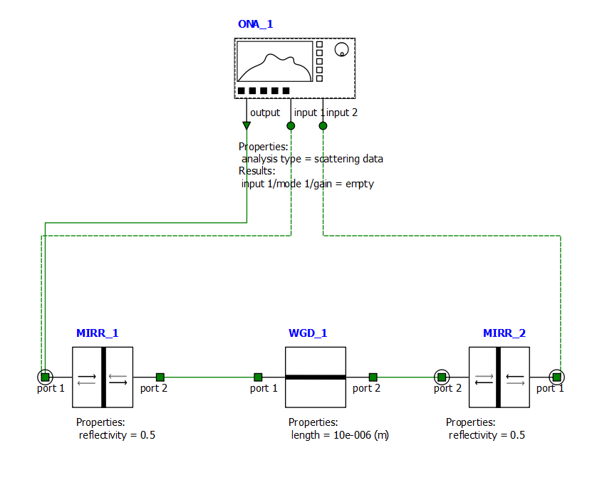
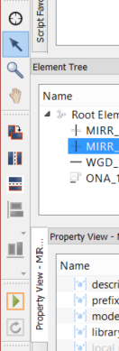
Fabry-Perot etalon simulation
To connect ports: click on one, drag, release on other
Note: Port 1 should be connected to the input port of the ONA
Select MIRR_2,
Horizontal flip

Slide 12
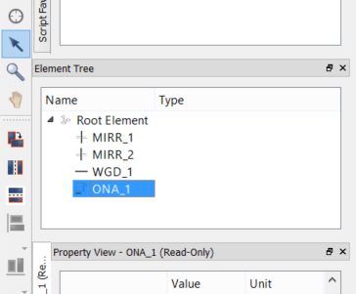
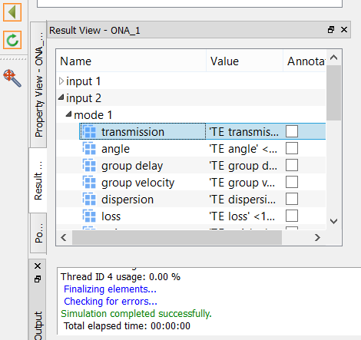
Fabry-Perot etalon simulation
Element tree:
Run the simulation
Click ONA in the Element tree. In the Results view right-click Input 2 → Mode 1 → transmission → Visualize → New Visualizer

Slide 13
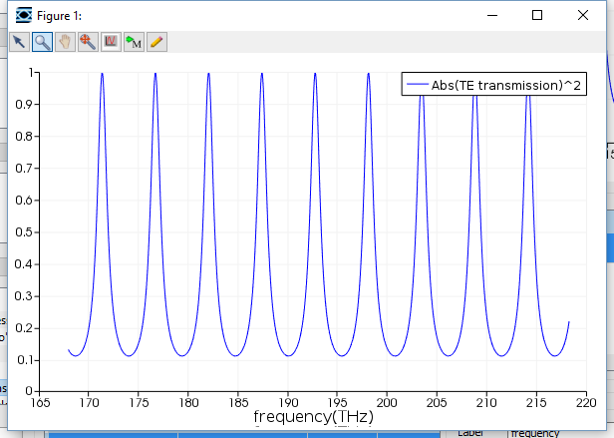
Fabry-Perot etalon simulation

Slide 14
Grating S-parameter
Optical fiber (not to scale)
$$S_{11}={\left.\frac{b_{1}}{a_{1}}\right|}_{a_{2}=0}$$
$$S_{22}={\left.\frac{b_{2}}{a_{2}}\right|}_{a_{1}=0}$$
$$S_{12}={\left.\frac{b_{1}}{a_{2}}\right|}_{a_{1}=0}$$
a₁
$$S_{21}={\left.\frac{b_{2}}{a_{1}}\right|}_{a_{2}=0}$$
b₁
Mode expansion monitor
a₂
$$Si$$
b₂
$$SiO_{2}$$
Mode expansion monitor
$$Si$$

Slide 15
Grating S-parameter
How do we get the field coefficients $a_{1},{ b}_{1}, a_{2}, b_{2}?$
Lumerical has built-in mode expansion monitor that can determine these coefficients and allow us to extract S-parameters.
The mode expansion assumes field can be expanded using the eigenmodes such that:
$a_{m}$ and $b_{m}$ are the complex modal coefficients and will be returned by the mode expansion monitor. Important: the coefficients are normalized to 1 V/m!
$$E= \sum_{m}{a_{m}E_{m}^{forward}+b_{m}}E_{m}^{backward}$$

Slide 16
Simulation #1
Optical fiber (not to scale)
$$S_{22}={\left.\frac{b_{2}}{a_{2}}\right|}_{a_{1}=0}$$
$$S_{12}=\sqrt{\frac{Power in fiber mode}{Power in waveguide mode}}{×\left.\frac{b_{1}}{a_{2}}\right|}_{a_{1}=0}$$
b₁
Mode expansion monitor
Necessary to deal with Lumerical normalization
a₂
$$Si$$
b₂
$$SiO_{2}$$
Mode expansion monitor
$$Si$$

Slide 17
Simulation #2
Optical fiber (not to scale)
$$S_{11}={\left.\frac{b_{1}}{a_{1}}\right|}_{a_{2}=0}$$
$$S_{21}=\sqrt{\frac{Power in waveguide mode}{Power in fiber mode}}{×\left.\frac{b_{2}}{a_{1}}\right|}_{a_{2}=0}$$
a₁
b₁
Mode expansion monitor
Necessary to deal with Lumerical normalization
$$Si$$
b₂
$$SiO_{2}$$
Mode expansion monitor
$$Si$$

Slide 18
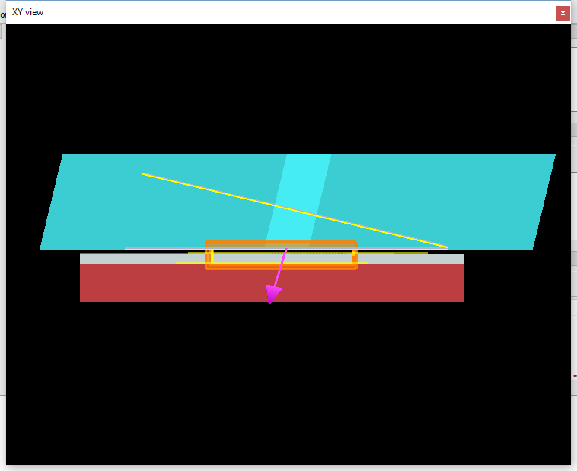
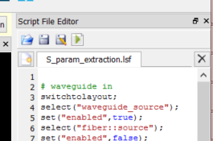
Grating S-parameter extraction
Open Lumerical FDTD file grating_coupler_S_param.fsp
Open Lumerical script S_param_extraction.lsf (click and drag into FDTD window)
You will see grating geometry that we simulated at the end of last discussion plus the addition of mode expansion monitors.
The script will run the simulation twice and automatically extract the S-parameters using the mode expansion monitors and save to a txt file.
Run the script.

Slide 19
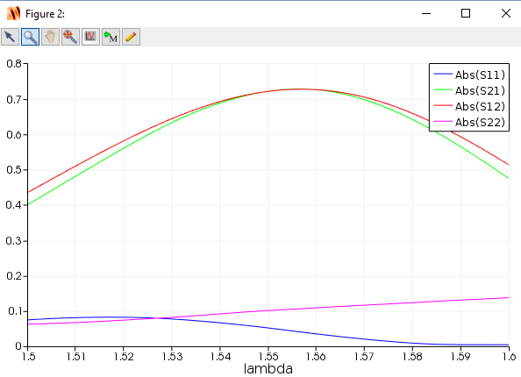
Grating S-parameter extraction
Strong reflections back toward source
Set Scalar operation → Abs again

Slide 20
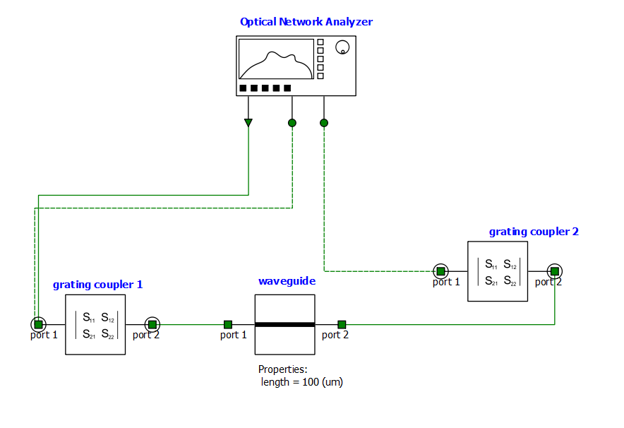
Grating S-parameter extraction
Open the Lumerical INTERCONNECT file grating_coupler_interconnect.icp

Slide 21
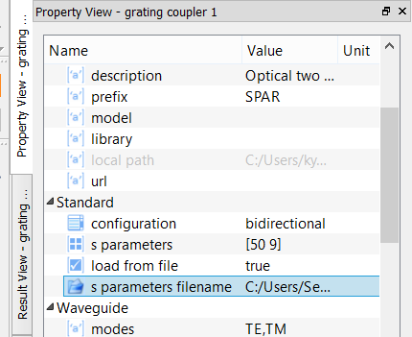
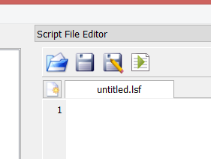
Import S-parameter
Select grating coupler 1 and within the Property View → Standard → s parameters file name, double click filename and click Open
Set load from file = true
Select the txt file grating_S.txt (generated from FDTD)
Repeat for grating coupler 2.
Open the Lumerical script file grating_coupler_interconnect.lsf (click and drag into window)
Run the script.

Slide 22
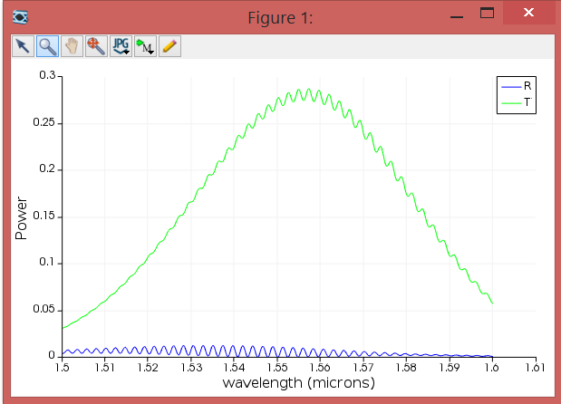
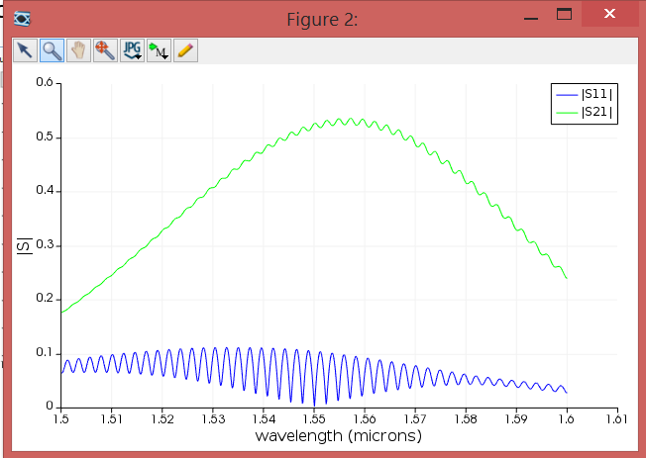
Grating + waveguide simulation
Reflectance / Transmittance
Combined S-parameter
Fabry-perot oscillations

Slide 23
Summary
This approach of extracting S-parameters and using INTERCONNECT to run a system level circuit simulation has two primary benefits:
Break large simulation up into smaller simulations to reduce memory requirement (may be useful for final project).
Import empirically extracted S-parameters to build physically based model of a full system.

